Slide 1
College of Agriculture and Life Sciences
Department of Horticulture Sciences
Plant Breeding Consortium
CS/HS 541 Plant Breeding Methods
Genomic matrices
Roberto Fritsche-Neto
Assistant Professor - Vegetable Molecular Breeding
2026

Slide 2
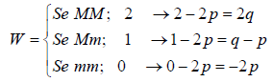
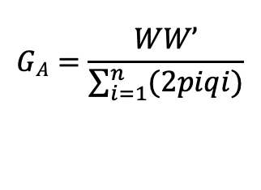
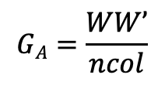
G_{A}
G_{A} – additive genomic relationship matrix
There are many methods
The most popular was proposed by VanRaden (2008)
Another way is to center and and scale the matrix first
W <- scale(M, scale = TRUE, center = TRUE)
G_{A} <- tcrossprod(W) / ncol(W)
$$GA=\frac{WW’}{\sum_{i=1}^{n}{(2piqi)}}$$
$$GA=\frac{WW’}{ncol}$$

Slide 3
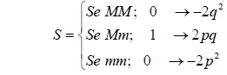
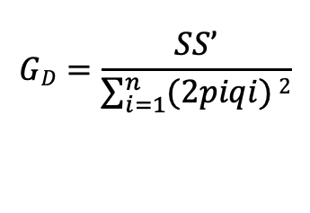
G_{D}
G_{D} – dominance genomic relationship matrix
Aa =1
Otherwise = 0
$$GD=\frac{SS’}{\sum_{i=1}^{n}{(2piqi)}2}$$

Slide 4
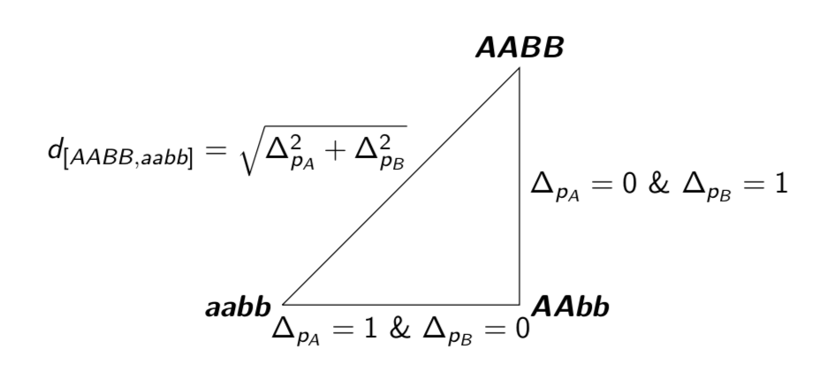
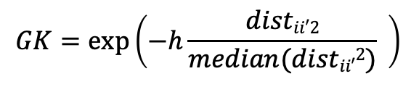
Gaussian kernel
GK – Euclidian genomic distance between individuals
Capture additive and non-additive effects
h = bandwidth parameters
Replace the diagonal with 1
$$GK=exp⁡\left(−h\frac{distii′2}{median(distii′2)} \right)$$

Slide 5

GxE
Additive by Environment
Kronecker product
Environment (diagonal)
$⨂$
G_{A} matrix

Slide 6
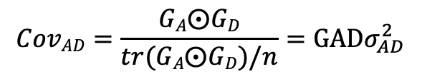
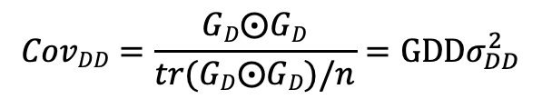
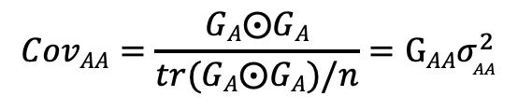
Epistasis
Hadamard product (Vitezica et al., 2017)
$$CovAA=\frac{GA⨀GA}{tr(GA⨀GA)/n}=GAAσ_{AA}^{2}$$
$$CovDD=\frac{GD⨀GD}{tr(GD⨀GD)/n}=GDDσ_{DD}^{2}$$
$$CovAD=\frac{GA⨀GD}{tr(GA⨀GD)/n}=GADσ_{AD}^{2}$$

Slide 7
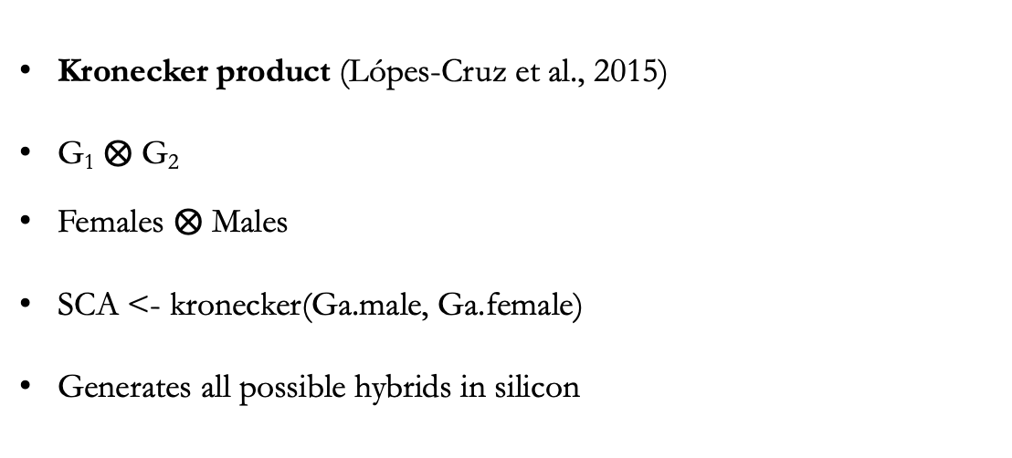
SCA
Kronecker product (Lópes-Cruz et al., 2015)
G₁ $⨂$ G₂
Females $⨂$ Males
SCA <- kronecker(Ga.male, Ga.female)
Generates all possible hybrids in silicon

